Slide 1

Stage 2 Strange Hallways Course Designer: Jordan Rogers
Strange Hallways is a 22 round, 110 point Comstock long course. There are 10 USPSA targets and 2 steel targets. The best two hits per target will score. Steel must fall to score. The start signal is audible.
The start position is standing with wrist below belt, loaded firearm lying flat and unsupported on top of the up-range barrel.
On the audible start signal, engage targets as visible from within the shooting areas. All barrels are soft cover.

Slide 2
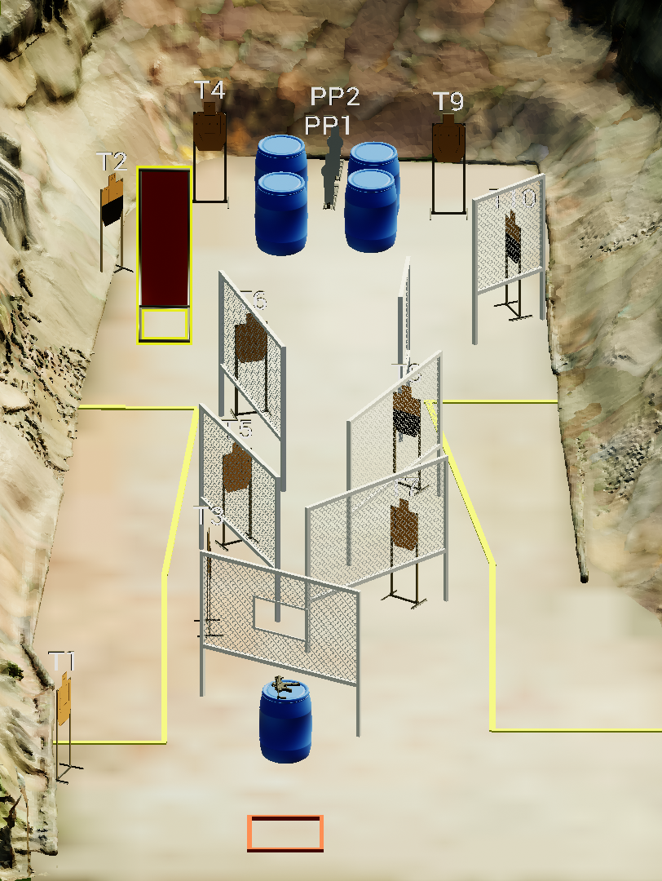
 | Stage 2 Strange Hallways Course Designer: Jordan Rogers

